Slide 1
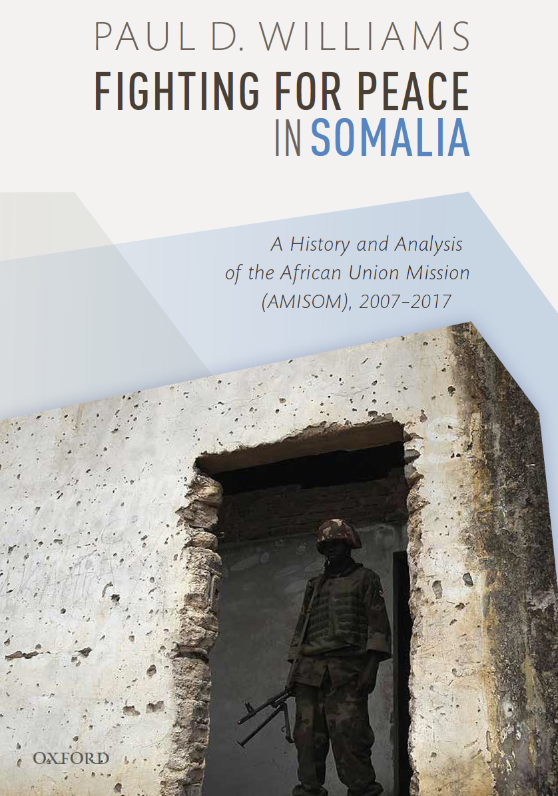
Fighting for Peace in Somalia: The African Union’s War Against al-Shabaab
Prof. Paul D. Williams
The George Washington University
24 May 2019

Slide 2
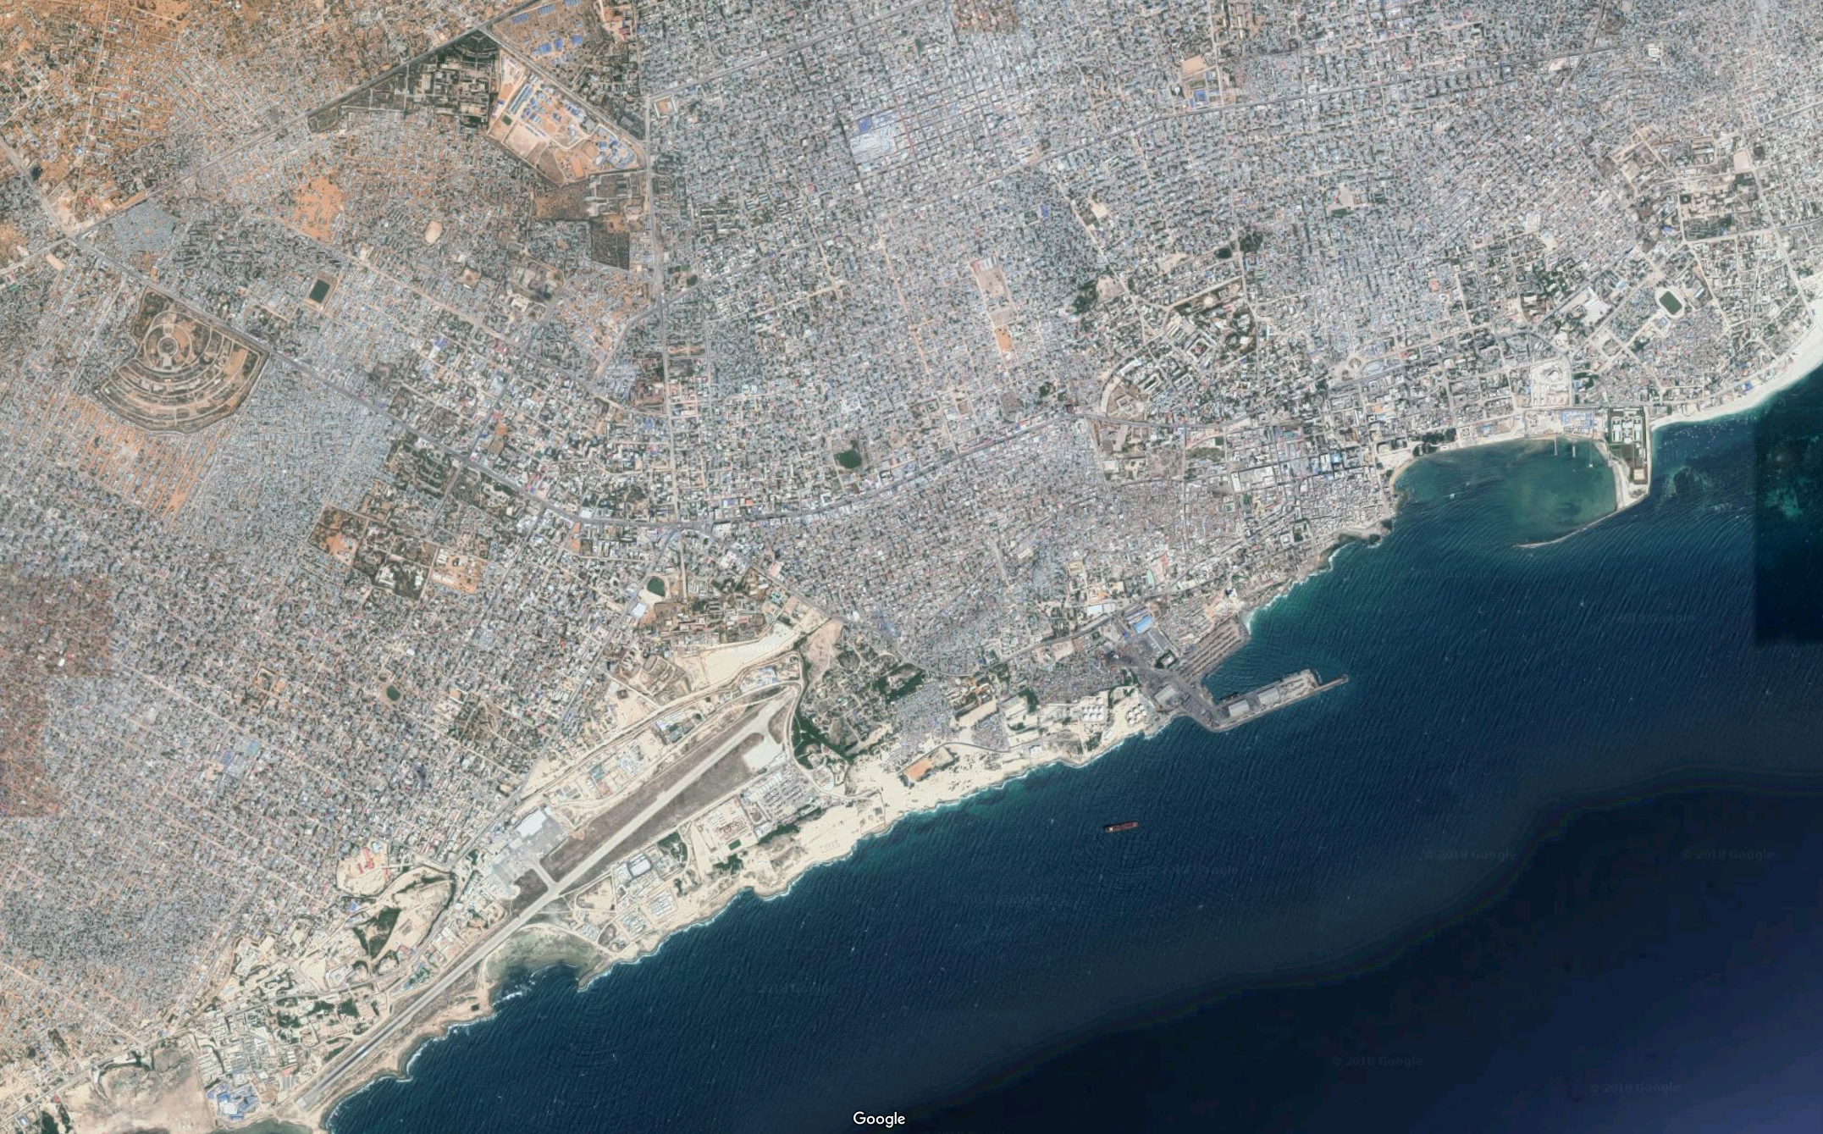

Mogadishu
March 2007

Slide 3
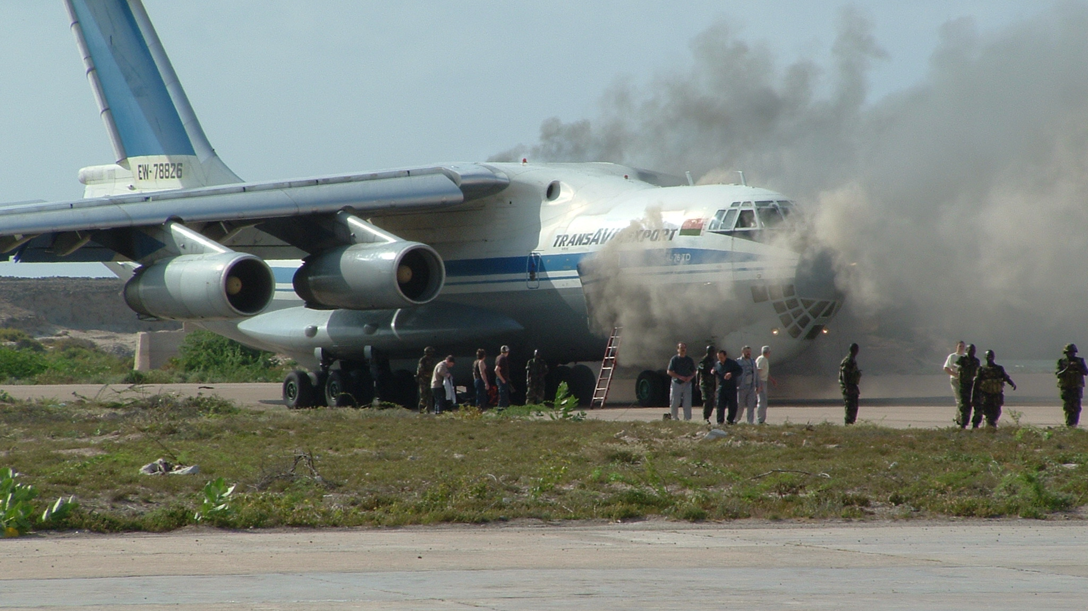
AMISOM transport plane, Mogadishu, 9 March 2007
Notes:
https://aviation-safety.net/database/record.php?id=20070309-0

Slide 4
Probably hit by an RPG

Slide 5
“When the plane was hit, we thought, oh, this is mission impossible!”
Gen. Levi Karuhanga
AMISOM Force Commander

Slide 6
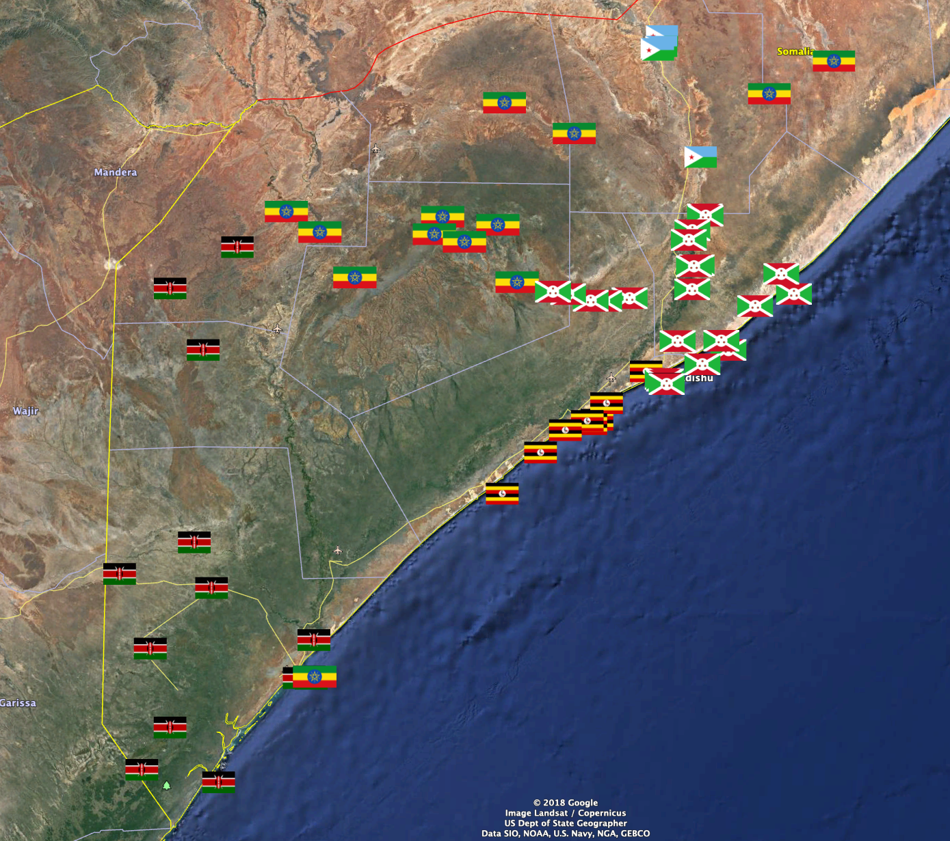
AMISOM Deployment 2015

Slide 7
AMISOM Today
19,500 soldiers
700 police
70 civilians

Slide 8
AMISOM’s Current Strategic Objectives
Reduce the threat posed by al-Shabaab and other armed opposition groups.
1
Secure the political process, stabilization efforts, reconciliation and peacebuilding.
2
Enable the transition of security responsibilities to Somali forces.
3

Slide 9
Why write this book?
Longest and largest AU mission.
By 2010, the world’s most deadly mission.
By 2014, costs approx. $1 billion p.a.
By 2017, world’s largest peace operation.
Key case for peace operations debates.
Nobody else was doing it…

Slide 10
Media
News reports
Blogs
Official docs
AMISOM
Inter. Orgs (AU, UN, EU)
Scholarship
Journal articles
Books
Internal strategic docs
Internal operational docs
MIPs & Annual Reports
Lessons Learned docs
Internal tactical docs
FC Directives
Contractors (IST, Bancroft)
Troops’ diaries
MAC Trends Analysis
Intelligence
AARs
Strategic Reviews
Consultancy reports
NGOs
Books by journalists
Social media
States
Think Tanks
CONOPS & TAMs
Op. Orders
Situation Reports

Slide 11
Part I:
History
Genesis Oct 2004—Mar 2007
Entry Mar 2007—Jan 2009
Stalemate Jan 2009—Aug 2010
Offensive Sept 2010—Oct 2011
Expansion Oct 2011—Sept 2012
Consolidation Sept 2012—Dec 2013
Surge Jan 2014—May 2017

Slide 12
Part II:
Challenges
Logistics
Security Sector Reform
Civilian Protection
Strategic Communications
Stabilization
Exit

Slide 13
AMISOM struggled to generate forces and lacked key capabilities…

Slide 14
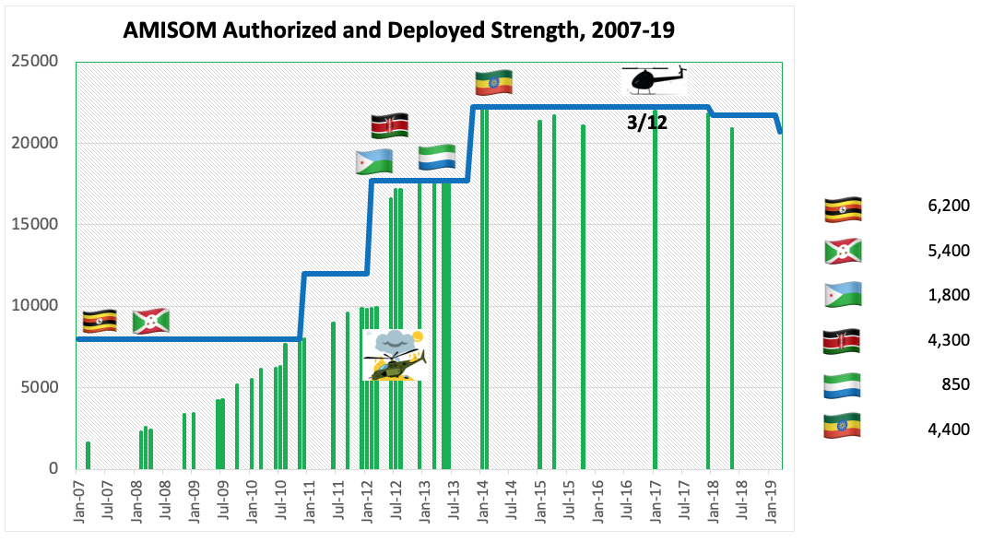

Slide 15
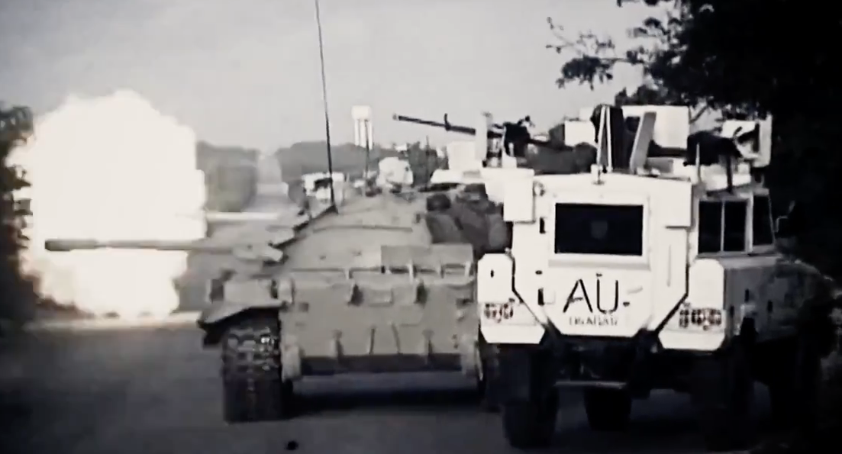
This wasn’t peacekeeping
Urban war + VIP protection + COIN + state-building + stabilization
Notes:
Mixture of urban war (street-to-street, and even hand-to-hand combat), COIN, state-building, VIP protection, and stabilization.

Slide 16
AMISOM became the most complicated peace operation in modern history…

Slide 17
The AMISOM Model
AMISOM
African TCCs
Uganda, Burundi, Kenya, Djibouti, Sierra Leone, Ethiopia
Bilateral “train & equip”
(esp. US, UK)
European Union
allowances + training mission
Parallel Operations Ethiopia, Kenya, USA + Somali Forces
United Nations
(mandates, logistics, missions, finance)
Bilateral donors (e.g. Canada, Japan, China etc.)

Slide 18
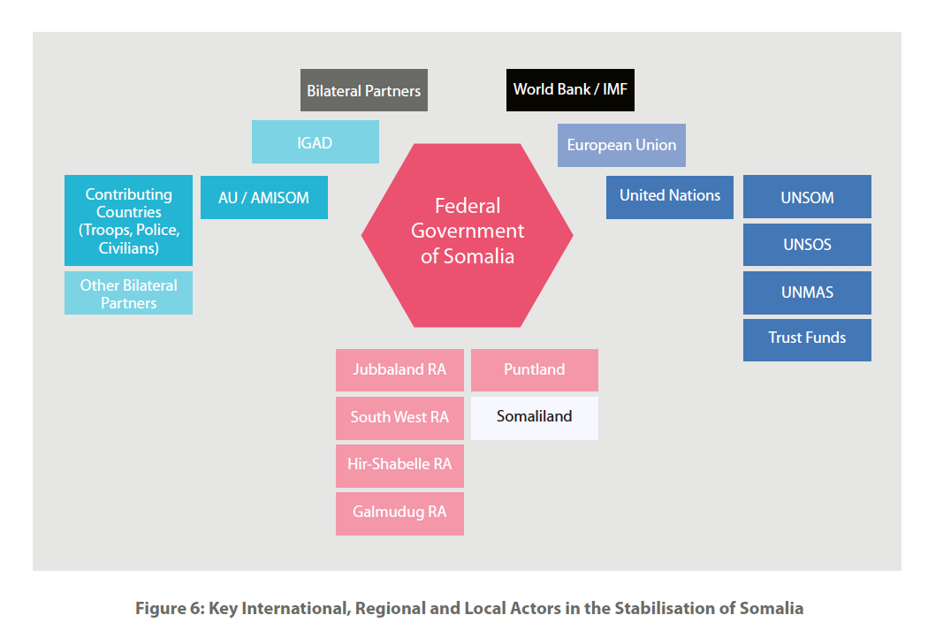
International Ecosystem to Stabilize Somalia

Slide 19
AMISOM was peacekeeping on the cheap and suffered financial shortfalls…

Slide 21
AMISOM faced a deadly, resilient and adaptable enemy…

Slide 22
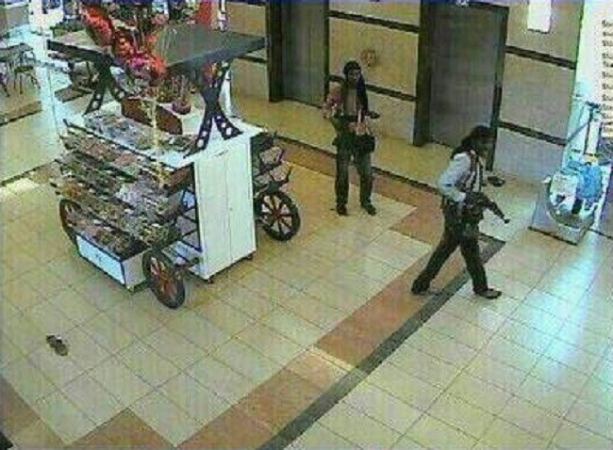
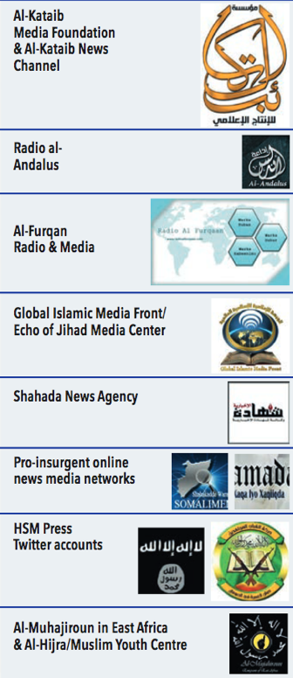
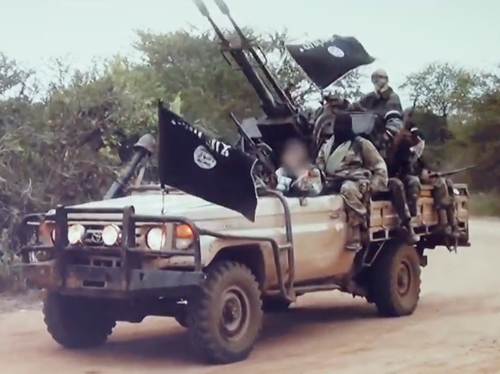
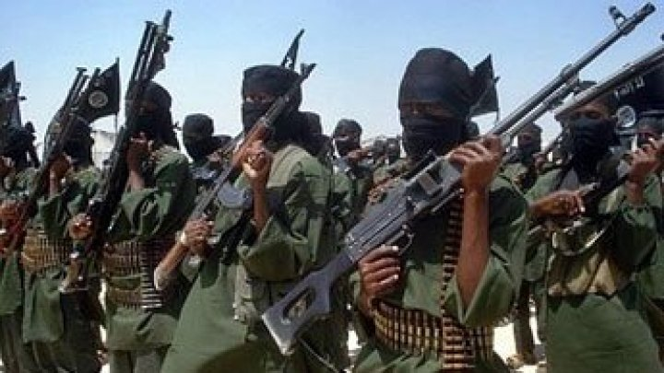

Slide 23
Has AMISOM made a positive impact?
Yes, but …

Slide 24
AMISOM’s Strategic Impact
2009
2011
2013-16
Facilitate withdrawal of Ethiopian troops.
Expel al-Shabaab’s main forces from the capital.
Help establish four new regional administrations.
ENDF Exit
Protect TFGs
Free Mogadishu
Recovery
IRAs Established
(s)elections
Protect two iterations of the Transitional Federal Government.
Recover approx. 30 towns across south-central Somalia.
Secured electoral processes for two Federal Governments.
2009-12
2012-15
2012/17
AMISOM has provided the security foundation that enabled most of the international diplomatic and humanitarian communities to operate out of Mogadishu and across south-central Somalia.

Slide 25
Major Problems
Lack of unified command and control.
Failed to consistently CLEAR, HOLD or BUILD.
Failed to secure the main supply routes.
Camouflage for partisan agendas of neighboring states.
Source of civilian harm, corruption and misconduct. Lost local perceptions.
Displaced rather than destroyed al-Shabaab’s key combat capabilities.

Slide 26
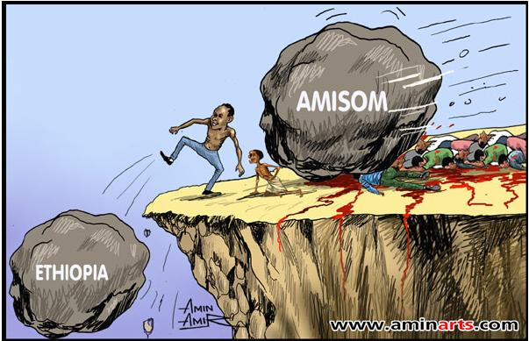
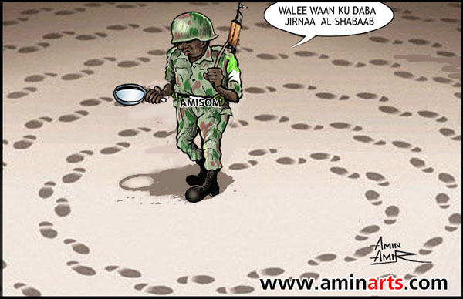
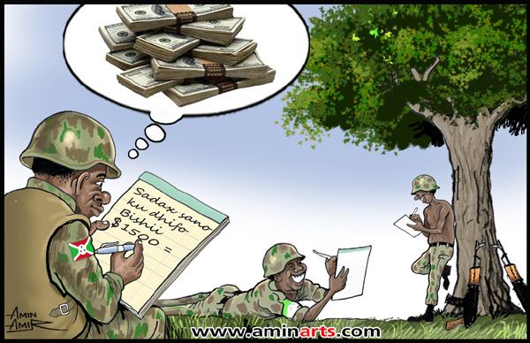
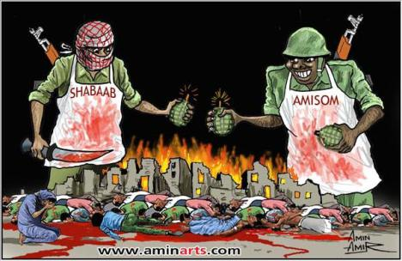
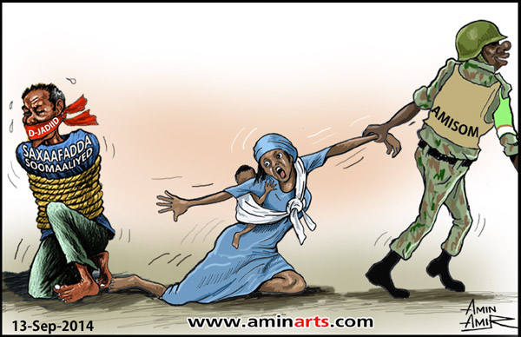
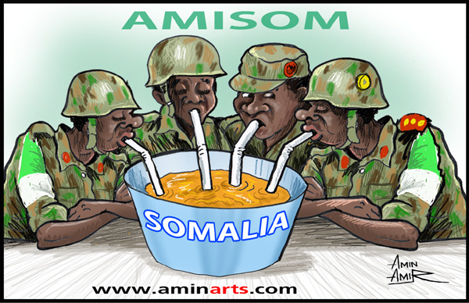
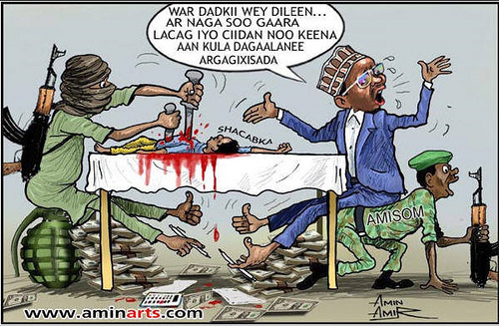
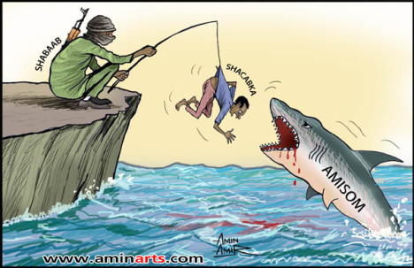

Slide 27
Partnership peacekeeping is the new normal in Africa. We have to do it better.
AMISOM
African TCCs
Uganda, Burundi, Kenya, Djibouti, Sierra Leone, Ethiopia
Bilateral “train & equip”
(esp. US, UK)
European Union
allowances + training mission
Parallel Operations Ethiopia, Kenya, USA + Somali Forces
United Nations
mandates, logistics, missions, finance
Bilateral donors (e.g. Canada, Japan, China etc.)

Slide 28
Success requires unified, sustained political support + the ability to exert leverage over local political elites.

Slide 29
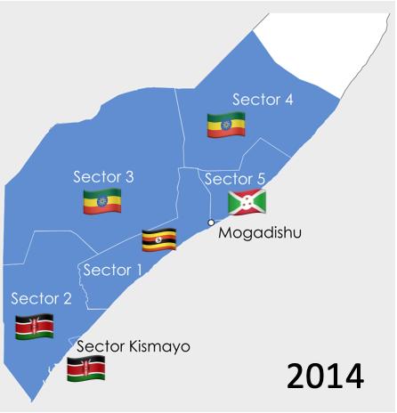
Without unified command & control a peace operation won’t be more than the sum of its parts.

Slide 30
Beware optimistic planning assumptions, especially about local security forces.

Slide 31
Logistics
Don’t expect success in war if you separate a commander from their logistics and rely on frameworks intended for peacekeeping.

Slide 32
Security Sector Reform
It’s the politics, stupid!
(And some technical stuff.)

Slide 33
Civilian Protection
Not having a mandate to protect civilians doesn’t insulate a mission from expectations to protect civilians.

Slide 34
Strategic Communications
Missions require built-in, flexible and resourced capacity to do effective strategic communications.

Slide 35
Stabilization
Effective local partners hold the key to delivering stability and a peace dividend to local populations.

Slide 36
Exit
Politics not plans determine exit.
Peacekeepers aren’t in control of their own successful exit.

