Slide 1
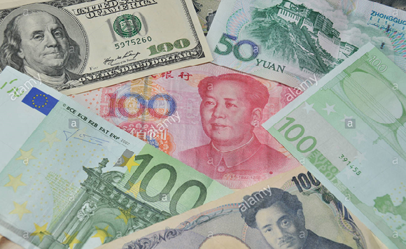
New global economic governance and currency multi-polarity
Carlo Monticelli
Vice-Governor
Council of Europe Development Bank

Slide 2
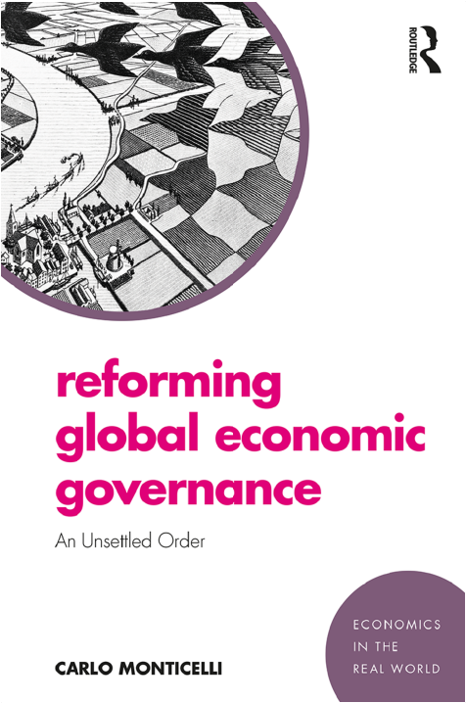
Background

Slide 3
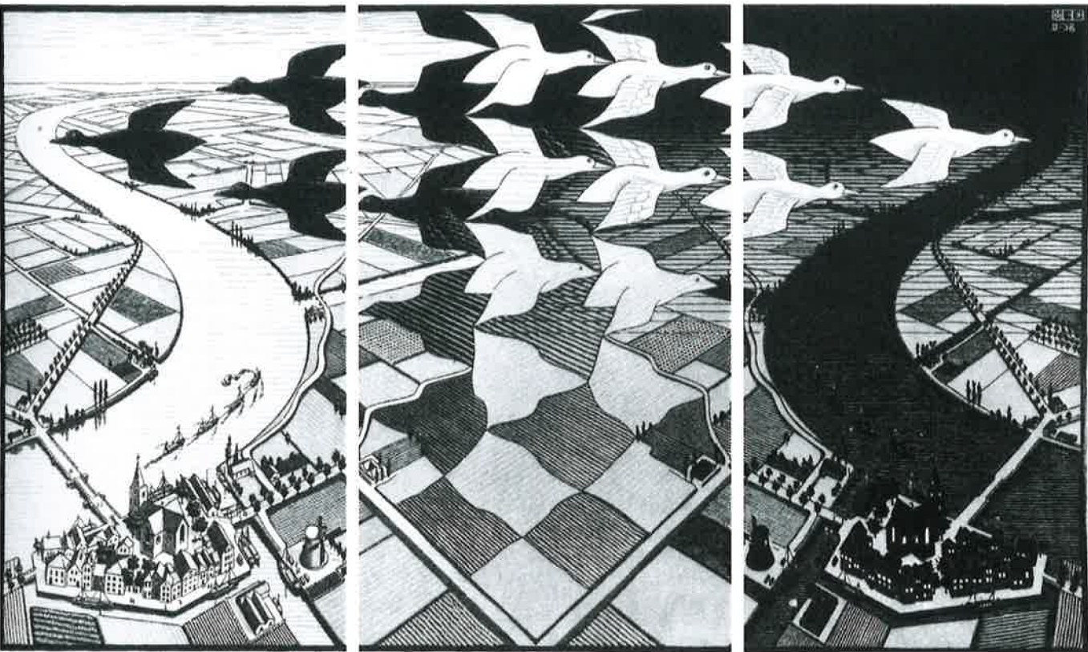
“The world as we know has come to an end”
Radical transformation with continuity

Slide 4
An unsettled order
Radical, unsettled reform in governance
Some academics disagree:
Drezner: The System Worked
Helleiner: Status Quo Crisis
Unsettled order, but order
Some academics disagree:
Bremmer & Roubini: G-Zero World
Temin and Vines: The Leaderless Economy

Slide 5
Brave new (old) world
Upheaval of power relations in global economy
There is no turning back

Slide 6
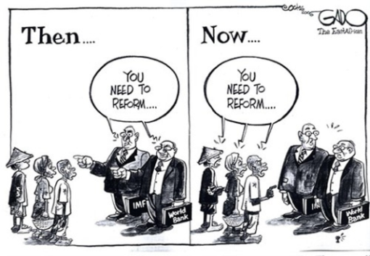
Pervasive reform
G7 → G20
IMF →
MDBs
FSF →
Europe →
More power in the "old" MDBs
Creation of two new ones (NDB + AIIB)
FSB and SSBs with the new powers as members (but still rule-taking)
Weak role in the reform (myopic and fractious inwardness)

Slide 7
The features of the new order
Key features of the reform:
Fragmentation
Purposeful experimentation
Inter-connectedness
Concern for inclusiveness in economic growth
Cross-cutting theme with a pervasive impact on national politics and international relations
The social media revolution

Slide 8
Wrap up
Daunting challenges while the global order remains unsettled in its architecture and institutional arrangements, yet better tools for global economic governance
“Never let a good crisis got to waste”: the 2008 crisis was not wasted
Radical change in the balance of power
Remarkable enhancement of its legitimacy
Considerable progress towards multi-polarity (even if Europe has been missing)
New array of institutional and operational tools → Enhanced flexibility and effectiveness of internationally-coordinated policy actions

Slide 9
Nationalism may, but need not, prevail
Challenges might appear insurmountable, but the tools to address them are available provided that the international community finds the resolve to use them
Currency multi-polarity is one of the tools

Slide 10

The 2008 crisis and the dollar
The great financial crisis seemed to undermine the pivot role of the dollar:
Gov. Zhou proposed replacing the dollar with SDR
Uneasiness within both the G7 and the G20
Despite the severe and persistence imbalances, the dollar crash never materialized. In 2009 the world still viewed the dollar as a safe haven and as the pivot international currency

Slide 11
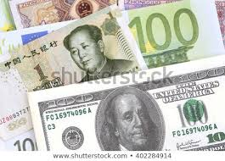
Several reasons for the exorbitant persistence of the dollar
Structural power in global economy, rooted in US geopolitical dominance and enduring military supremacy
Inertia in quoting and invoicing
Absence of immediately viable alternatives
Renminbi is not backed by deep and resilient financial markets and China’s capital account and financial industry not yet liberalized
Euro lacks adequate institutional background and political cohesion (also a cause of Europe’s weak role in global financial governance)
Dominance of the US banks in global finance (which in turn leads to an overwhelming influence on global regulatory standards)
Direct access to the Federal Reserve’s dollar facilities necessary to run a global business (chartered in the US → subject to US regulation)

Slide 12
What is next?
Fundamental factors undermining the dollar do remain and the process of reform in global governance is proceeding in earnest
Persistent imbalances in flows and stocks
Emerging markets’ greater economic and political weight, particularly China
“This time it’s real” – Layne (2012)
Dollar status still openly questioned (e.g. G20 Financial Safety Net WG)

Slide 13
Triffin’s dilemma today
Considerable changes since Triffin’s times:
There is no longer a fundamental global liquidity shortage – public and private sources of international liquidity
The framework of International Monetary System has considerably changed (floating exchange rates)
Appearance of credible alternatives to the dollar (even though not fully mature yet)
But the tension between domestic policy concerns and global stability remains → Triffin dilemma is alive and kicking
Demand for safe assets → US exorbitant privilege → weaker market discipline
Imbalances continued to mount, undermining the value of the dollar
The elephant in the room: huge stock imbalances (most notably bilateral)

Slide 14
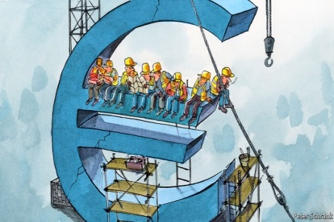
Transition to a brave new multipolar world
Combination of a market-driven process and public management (otherwise risk of financial stability – e.g. Woodford, 1990)
Euro and renminbi: Slowly but surely coming of age (Mercury mostly there; maybe Eirene rather than Mars)
International role of the euro, is one of the reasons why a stronger Europe is good for the world (there are others too)

Slide 15
Conclusion
Global governance is undergoing a deep transformation, setting the stage for a multi-polar currency system
A multi-polar currency system:
Gradual, by its nature, with the dollar still remaining for a long time “first among equals” (precedent of the long decline of the pound)
Combination of a market driven process and public guidance (Woodford, 1990)
Can the SDR help address the problem of stock imbalances?
Euro and the renminbi slowly but surely coming of age

Slide 16
Flow imbalances
Sources: OECD (2019)

Slide 17
Stock imbalances
Sources: Lane and Milesi-Ferretti (2017)

Slide 18
Stock imbalances
Sources: Lane and Milesi-Ferretti (2017)

