Slide 1
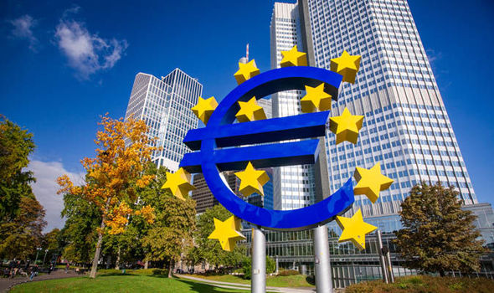
Redesigning the global monetary infrastructure
Carlo Monticelli’s new book: Unsettled order: reforming global economic governance
Comments by Wim Boonstra
(ELEC, Vrije Universiteit Amsterdam, Rabobank)
Brussels, June 11, 2019

Slide 2
Introduction
Monticelli’s is a rich book, covering many aspect of global economic, financial and political gorvernance.
It is a highly relevant book in a time when the US is increasingly unstable and undermining the multinational framework and in which international governance is under pressure, due to a world-wide reflex towards new nationalism and protectionism.
In my presentation I will focus on the reform of the international currency system.

Slide 3
The post-Bretton Woods system
US dollar
(informal anchor currency, float)
Euro
(float, regional anchor currency)
Satellite currencies
Satellite currencies
Swiss franc
Pound Sterling
Chinese renminbi
Japanese yen
Other, smaller currencies

Slide 4
Since 1945, the dollar is dominant (shares, %, 2017. Source: European Central Bank)

Slide 5
Problems with the dollar standard
Exorbitant privilege: US have no limits on foreign spending and borrowing as long as the dollar is the world’s currency standard
Political dominance
When the dollar depreciates, the US external investment position increase
US responsible for global financial stability ==> national interests will prevail
Dollar increasingly unstable due to deteriorating US financial strength ==> the world largest debtor ==> surplus countries hold huge reserves in a currency that may be bound to lose value in a substantial way

Slide 6
The US international investment position (1976 – 2018; data in USD billion, source BEA)

Slide 7
Impact of exchange rate on external assets US

Slide 8
The advantages for the US may be clear, but what about the disadvantages?
The world needs dollars ==> currency structural overvalued.
This is one of the reasons why the US has a structural CA deficit
Financing this deficit is no problem at all (see above). But it also means that part of the US economy is losing competitiveness
For Europe, a structurally stronger euro could turn out to be a big problem.
Especially for the countries that already have the weakest competitive positions.

Slide 9
Strengthening the euro is a good idea, but…
……..strengthening the euro means above all strengthening EMU
……..improvements of national financial and economic policies are essential
Labour market reform, sound fiscal policies, etc.
…….strengthening of EMU includes:
Completion Capital Market Union, including the creation of a EMU-wide safe asset.
Completion of Banking Union (including EDIS)
Cross-border labour market integration
Real convergence
A more prominent euro without these reforms may in the end bring disadvantages!

Slide 10
EMU: one currency, but many effective exchange rates (Real Effective Exchange Rates Eurozone, Jan 2002 = 100, source: Macrobond)

Slide 11
Is a global currency standard necessary?
Why not just a multipolar system with several, more or less equally important currencies, such as the dollar, the euro or, in the longer term, the Chinese renminbi?
The problem: world markets will always try to find a common denominator (a global standard for commodity pricing, trade currency, investment currency, vehicle currency and ‘safe asset’. )
Therefore, a multipolar system may turn out to be fundamentally unstable and any successor would be relatively weak from the start.
Moreover, moving to another anchor currency would simply shift the fundamental problems of the dollar standard to the next currency standard.
My conclusion: a global standard is essential, but should not be based on the currency of an individual country. The SDR is potentially a proper candidate.

Slide 12
Why an SDR-based system?
No exorbitant privileges for individual countries
Seigniorage income goes to global institution
No trade-off between domestic and international responsibilities
No special position for individual currencies
More disciplinary market forces for national policy makers

Slide 13
A redesigned SDR
SDR as a fixed basket
Essential is the development of private markets in SDR (like the private ECU)
Markets should start to denominate commodity prices in SDR
More currencies into the SDR
But not including all member currencies (inpractible)
Including (max.) the ten largest (key) currencies in the world
Only fully convertible currencies are to be included (note: the renminbi is not!)
Other currencies are free in their policy regime.
The result: floating currency blocks, around a SDR standard

Slide 14
A new SDR based system: the advantages
Removal of wrong incentives, such as
Building of unnecessary high reserve levels
Creation of large deficits and debts by anchor country
Elimination of trend towards global balance of payments imbalances
Right incentives: influence of weaker currencies declines, and of stronger countries increase ➔ gradual and flexible process
Stability of the global standard is not any longer dependent on the economic policies of a single country (with wrong incentives……)

Slide 15
Necessary precondition: A new role for the IMF
More automatic role as lender of last resort decreases the need for huge reserves ==> less incentives to build up large CA-surplusses
Monitoring of balance of payments positions of both deficit and surplus countries
More balanced representation in IMF and World Bank
No place for individual European countries?
Less influence for traditional industrial countries
More influence for emerging economies
Maybe managing the SDR could be outsourced to the BIS

Slide 16
Conclusion
A global currency, based on the currency of a prominent country, is by definition unstable.
As long as the Eurozone is not an effective Optimal Currency Area, it is not very wise to strive after a more prominent role of the euro. It simply may aggravate the tensions in the Eurozone.
In the short term, it is imperative to strengthen EMU’s weaknesses
In the longer term, a euro which is more or less at par (in importance) with the US dollar is a good thing, but preferably in the context of a global SDR-standard

Slide 17
Thank you for your attention
Find our research on https://economie.rabobank.com

