Slide 1
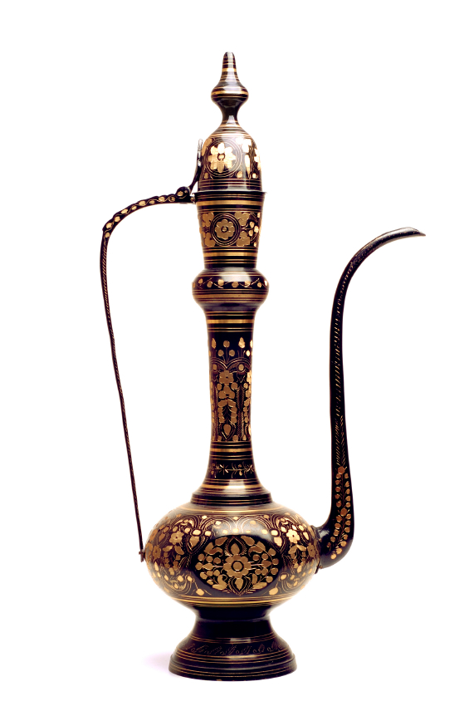
Islamic Finance Would you rather go for 3 wishes or for countless opportunities? Comparison with conventional banking The Luxembourg case
27 November 2012

Slide 2
Agenda
1
Main principles / Differences with conventional banking
2
Examples
3
Islamic Finance in Luxembourg

Slide 3
Islamic Finance Main principles
Sharia
Key terms : co-investing, partnership-like, exposure to profits & losses of underlying business or assets
Ethical restrictions
Role of Sharia’a Board
Financial restrictions
Different schools of interpretation
Regional differences

Slide 4
Islamic Finance Differences with conventional banking
How does this translate to main differences between Islamic and conventional
banking ?
CONVENTIONAL BANKING | ISLAMIC BANKING
No Sharia’a based principles | Based on Sharia’a (ethical and financial restrictions, Sharia’a Board)
Transactions and products predominantly based on pre-determined interest rates | Promotes risk sharing between investor (and/or the bank) and entrepreneur (the investor often is similar to a JV business partner).
Emphasis on credit-worthiness of the client | Emphasis on viability of underlying business (projects / assets)
Penalties, compound interest in case of default | Only small compensation possible in case of default, and given to charity

Slide 5
Agenda
1
Main principles / differences with conventional banking
2
Examples
3
Islamic Finance in Luxembourg

Slide 6
Examples of Sharia'a products & structures Islamic banking business is very different from conventional banking
Example: financing of acquisition of a car
Car delivery
Car dealer
30.000€
Resale price: 42.000€
Repayment : 60 months
at 700€ / month
Bank client
2. Car purchase contract
1. Promise to acquire car
3. Murabaha resale of car
+ Wakala agreement
Financing cost: 12.000€
Is this interest ?
Islamic bank
What is the typical tax issue if the car were a house ?
Bank margin:
42.000 – 30.000 = 12.000€
Is this interest ?
When is the margin taxed ?

Slide 7
Examples of Sharia'a products & structures Capital guaranteed funds
Investors
(Rab al Mal)
Mudaraba
Lux Sharia’a Fund
Fund Manager (Mudarib)
95% of fund assets
Expected
100% return at maturity
5% of fund assets invested
into Arbun
Depending on shares spot price,
Arbun is exercised or not
Murabaha transactions
Arbun
Sharia’a compliant shares

Slide 8
Examples of Sharia'a products & structures Sukuk
Example of Sukuk Ijarah
Investors
G. Profit payments
and Sukuk redemption
D. Proceeds from
Sukuk issuance
C. SPV issues Sukuk
Lux SPV
F. Payment of lease
Rentals to SPV
B. SPV leases assets
back to Project Co
E. Sales price
A. Sale of assets
to SPV
Project Co
Real Estate
Often called “Islamic Bonds”; however very different from bonds: undivided and proportionate ownership in underlying asset(s)

Slide 9
Agenda
1
Main principles / differences with conventional banking
2
Examples
3
Islamic Finance in Luxembourg

Slide 10
Islamic Finance in Luxembourg Not something new
Historically, a laboratory for Islamic finance and on the forefront since the 1970s:
1978: first Islamic institution in Europe
1983: first Takaful in Europe
1990s: Sharia’a funds in Luxembourg
2002: first European stock exchange to list Sukuk
2009: first European Central bank to become IFSB member
2011: first European member hosting annual IFSB conference
2011: first European Central bank participating to IILM

Slide 11
Islamic Finance in Luxembourg Not something new
Increased efforts from the industry and the government to attract more business in this segment since +5 years
Governmental Task force set up in April 2009
ALFI Middle East working group / LFF working group
Regular missions of finance and economy ministers to the region;
Bahrain and UAE in January 2010,
Saudi Arabia in May 2010
Lebanon in June 2010
Abu Dhabi, Riyadh and Beirut in February 2011
Singapore and Malaysia in October 2011
Qatar and Dubai in February 2012
Luxembourg School of finance and Luxembourg banking training institute launched Islamic Finance courses / IFQ exam can be done in Luxembourg
DB domiciled its new Islamic Finance platform Al Mi’yar (“The Standard”) in Luxembourg in 2009
BLME based its Islamic equity offering in Luxembourg in 2009
Luxembourg government announced it considers issuing Sukuk for covering its financing needs (2013?)

Slide 12
Islamic Finance in Luxembourg DTT network with countries having significant Muslim population
DTTs in force
DTTs pending
Azerbaijan
Bahrain
Indonesia
Malaysia
Morocco
Qatar
Tunisia
Turkey
UAE
Uzbekistan
Albania
Egypt
Kazakhstan
Kirgizstan
Kuwait
Lebanon
Oman
Pakistan
Syria
Saudi Arabia
Tajikistan

Slide 13
Islamic Finance in Luxembourg Tax authorities confirmed level playing field
Luxembourg tax authorities issued circulars on Islamic Finance:
Direct Tax circular (January 2010):
Clarifies the direct tax treatment of various Islamic financing arrangements and issues.
Deals with the tax treatment of Murabaha and Sukuk but also describes other instruments, such as Musharaka, Mudaraba, Ijara, Ijara-wa-lqtina and Istisna.
Indirect tax circular (June 2010) :
The circular covers some VAT and transfer tax issues related to Murabaha and Ijara agreements.
The circular provides for an extension of the existing tax incentives in the field of transfer taxes and VAT to Murabaha and Ijara operations.
The two circulars strengthen the substance over form approach adopted by Luxembourg tax authorities in order to reach a level playing field

Slide 14
Opportunities through Luxembourg
Growing appetite for GCC investors to invest outside GCC
Recent events in ME
Growing appetite for Sharia’a products (also in EU / also conventional investors)
Broad range of regulated / unregulated vehicles (eg. SIF, SPF, Soparfi)
Oppourtunities for retail banking and insurance ?
Sukuk issuance as a means to draw capital / to provide financing to market
Conventional players in Luxembourg developing Sharia’a products

Slide 15

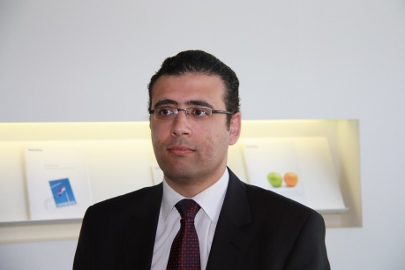
Contact persons
Alain Verbeken
Ashraf Ammar
Directeur
Cross-Border Tax – GFSI
Tel: +352 451 452 513
Mobile: +352 621506 508
alverbeken@deloitte.lu
Senior Manager
Cross-Border Tax – M&A
Tel: +352 451 452 058
Mobile: +352 661451 503
aammar@deloitte.lu

Slide 16

Deloitte refers to one or more of Deloitte Touche Tohmatsu Limited, a UK private company limited by guarantee, and its network of member firms, each of which is a legally separate and independent entity. Please see www.deloitte.com/about for a detailed description of the legal structure of Deloitte Touche Tohmatsu Limited and its member firms.
Deloitte provides audit, tax, consulting, and financial advisory services to public and private clients spanning multiple industries. With a globally connected network of member firms in more than 140 countries, Deloitte brings world-class capabilities and deep local expertise to help clients succeed wherever they operate. Deloitte's approximately 170,000 professionals are committed to becoming the standard of excellence.
Notes:
16

